Slide 1
DECONSTRUCTING MYTHS OF MOTHERHOOD:
YOUNG WOMEN AND THE MAKING OF POSITIVE FUTURE SELVES
SAMANTHA REVELEY • LECTURER AT THE UNVIERSITY OF SUNDERLAND

Slide 2
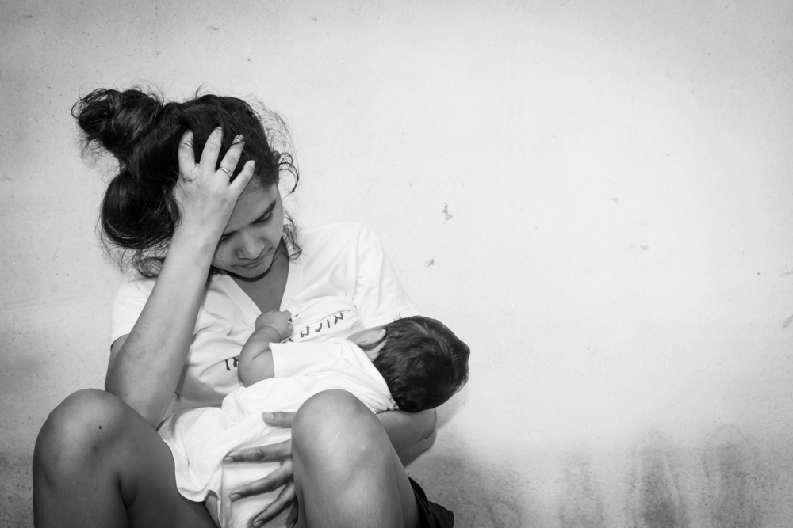
BECOMING A MOTHER
Transitioning into motherhood is a major life course event for women and is one that can be fraught with difficulties due to the uncertainty and instability which accompanies it.
Identity is known to play a key role in the transition yet approaches to understanding its role tend to be static and fixed.
As this study explored the experiences of ten women's transitions into and across motherhood clear links were identified between their perceptions of their self and the myths of motherhood which are deeply entrenched within societal understandings of motherhood.

Slide 3
‘Natural’ Maternal Instinct
Children need mothers, mothers need children and all women need to be mothers’
Ideologies of motherhood are embedded within the notion that women have an innate biological drive that makes them natural mothers.
Despite this there is no evidence of any biologically based drive which fuels the innate desire to be a mother.
This drive is instead, arguably culturally induced through socialisation across time and place.
(Oakley, 1987, p.187).

Slide 4
Contemporary society’s ideology of motherhood undermines the status of women as individuals through the expectation that they will forgo their independence and identity.
Badinter holds liberal motherhood as an unlikely contributing force as it has fuelled an obsession with the ‘earth mother’; a woman who practices attachment parenting, exclusive breastfeeding, baby wearing, co-sleeping and baby led weaning (Badinter, 2011).
This image of a natural earth mother places nonconforming women under great pressure, with those who fail to mother in this way often experiencing feelings of inadequacy and shame.
The Paradox of Liberal Motherhood

Slide 5
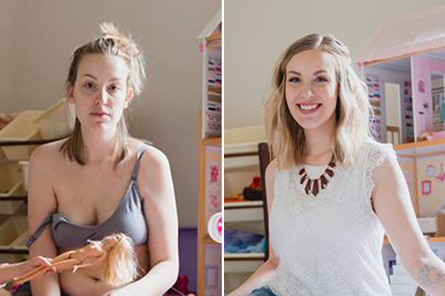
The ‘mask of silence’ has become a prominent concept within motherhood studies.
The concept describes how new mothers are often not upfront about their struggles as a new mother and tend not to share these struggles with other mums.
This mask of silence surrounds and oppresses almost all aspect of parenting from pregnancy and childbirth to the entire child rearing process.
This silence enables the continual perpetuation of the myth that motherhood is a natural, trouble free and blissful experience.
The Mask of Silence

Slide 6
Everyone else was doing amazing and then there was me... struggling to get out of bed in the morning, never mind look after the baby. I was forcing myself to get up and do my hair and makeup and to just keep going through the motions and smiling. If people asked how I was I would say how wonderful being a mum was and how much I loved doing it because they didn’t really want to know. It was ridiculous, but I didn’t feel like I could say anything without people thinking I was a bad mum.
Joanne, 25

Slide 7
Women’s expectations of motherhood are heavily influenced by the ideology which leads to conflict when their experiences do not match up to their expectations.
Feminism empowered women and them with greater prospects in the work place. An inadvertent impact of these new found prospects however was the emergence of the ‘supermom’ or ‘have it all’ mother who successfully balance work life, domestic life and motherhood.
Those who struggle to balance the three tend to be pitied or seen as a failure, which Maushart’s work suggests is why women hide behind a mask of silence rather than confide in other mothers.
Super Mom, Super Wife… Super Everything

Slide 8
I had to go back to work pretty much straight away. He was only four months old, but we couldn’t afford for me not to work. It was a nightmare, I went from being in this great little bubble with the baby to all of a sudden being back at work and having to worry about childcare, food shopping, washing, work. I just couldn’t cope with having to be everything and everywhere all at once. I ended up having a breakdown before I could accept that enough was enough and something had to give.
Lucy, 31

Slide 9
Women themselves can begin to challenge this image of the ‘ideal’ and ‘good’ mother by outwardly sharing their authentic experiences of motherhood, warts and all, and how those experiences were lived in their day to day lives (Badinter, 2011).
Candidly sharing these experiences will empower women by showing them that while motherhood itself is universal, each woman’s experience of it is diverse and varied with the reality of motherhood being different for each individual.
Sharing these experiences will also equip women with a more realistic perception of motherhood and will help them to develop more positive identities and perceptions of the self as they can see that difficulty adapting does not equate to being a failure.
Changing the Narrative, Changing the Experience

Slide 10
Conclusion
Each woman’s experience of motherhood is valued and authentic, regardless of whether it conforms to social expectations, and a failure to acknowledge this will continue the perpetuation of an often psychologically damaging false ideal.
By acknowledging the diversity of experiences of motherhood, we can deconstruct the damaging myths surrounding mothering to support women in formulating a positive future self.

